Slide 1
Bug Classification App
By Ethan Britton

Slide 2
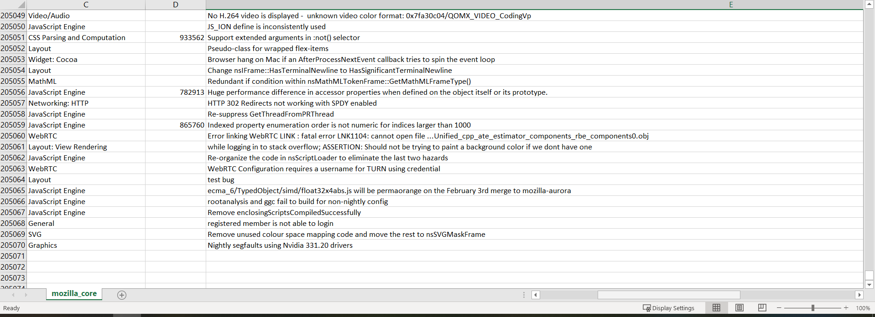
Introduction
Hundreds of Thousands of Bugs
Little analysis / way to condense
Relevancy
Too much for manual analysis

Slide 3
Introduction
Problem for Developers
Aiming To Fix Certain Areas
Classifying bugs efficiently and effectively
Few similar apps
Saves Developers tons of time

Slide 4
Techniques
Python is the primary language
App has two main components
Frontend (UI)
Backend (ML)
Backend uses machine learning – Text Classification
Frontend provides interface for developers
Web Application – Launched at http://127.0.0.1:5000
Also provides results
Goal to have interactive frontend

Slide 5
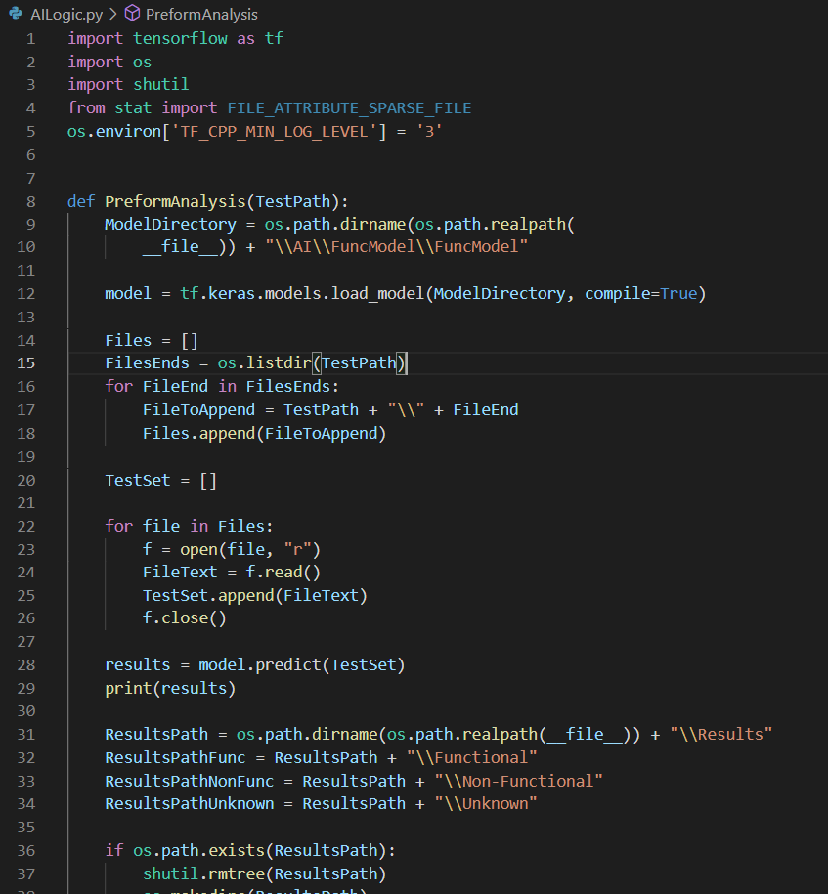
Implementation – Backend
Backend is implemented in python
Involves training and maintain a model
Uses Tensorflow – Open Source MachineLearning
Model is trained prior to app launch, can be retrained
Includes logic for processing data and running model

Slide 6
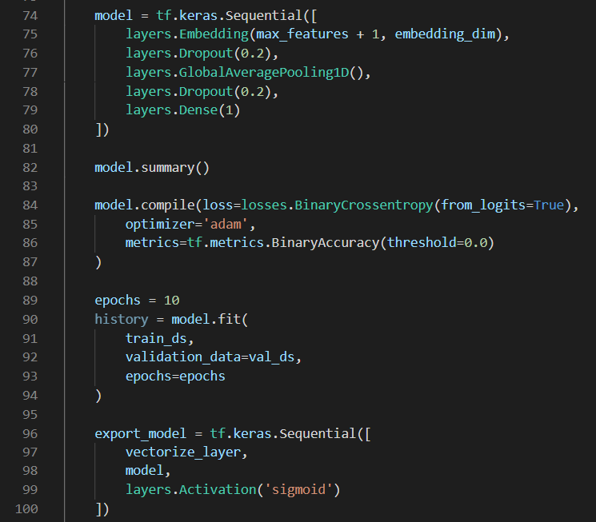
Implementation – Model
Model is a basic text classification model
Training and Validation First Preprocessed
Remove characters, strip spaces
Converted to Vectors
Model constructed contains 5 layers
Model Trained and Validated
Model wrapped in text vectorization layer for deploying
Model saved

Slide 7

Implementation – Backend
Backend receives upload of bugs from user
Model is Pretrained
Mounts model and runs classifications on all bugs
Sorts bugs based on results
Returns results to frontend

Slide 8
Implementation – Frontend
Frontend is constructed using Flask
Flask acts as a backend and frontend for web applications
Serves html and css
Contains 3 pages

Slide 9
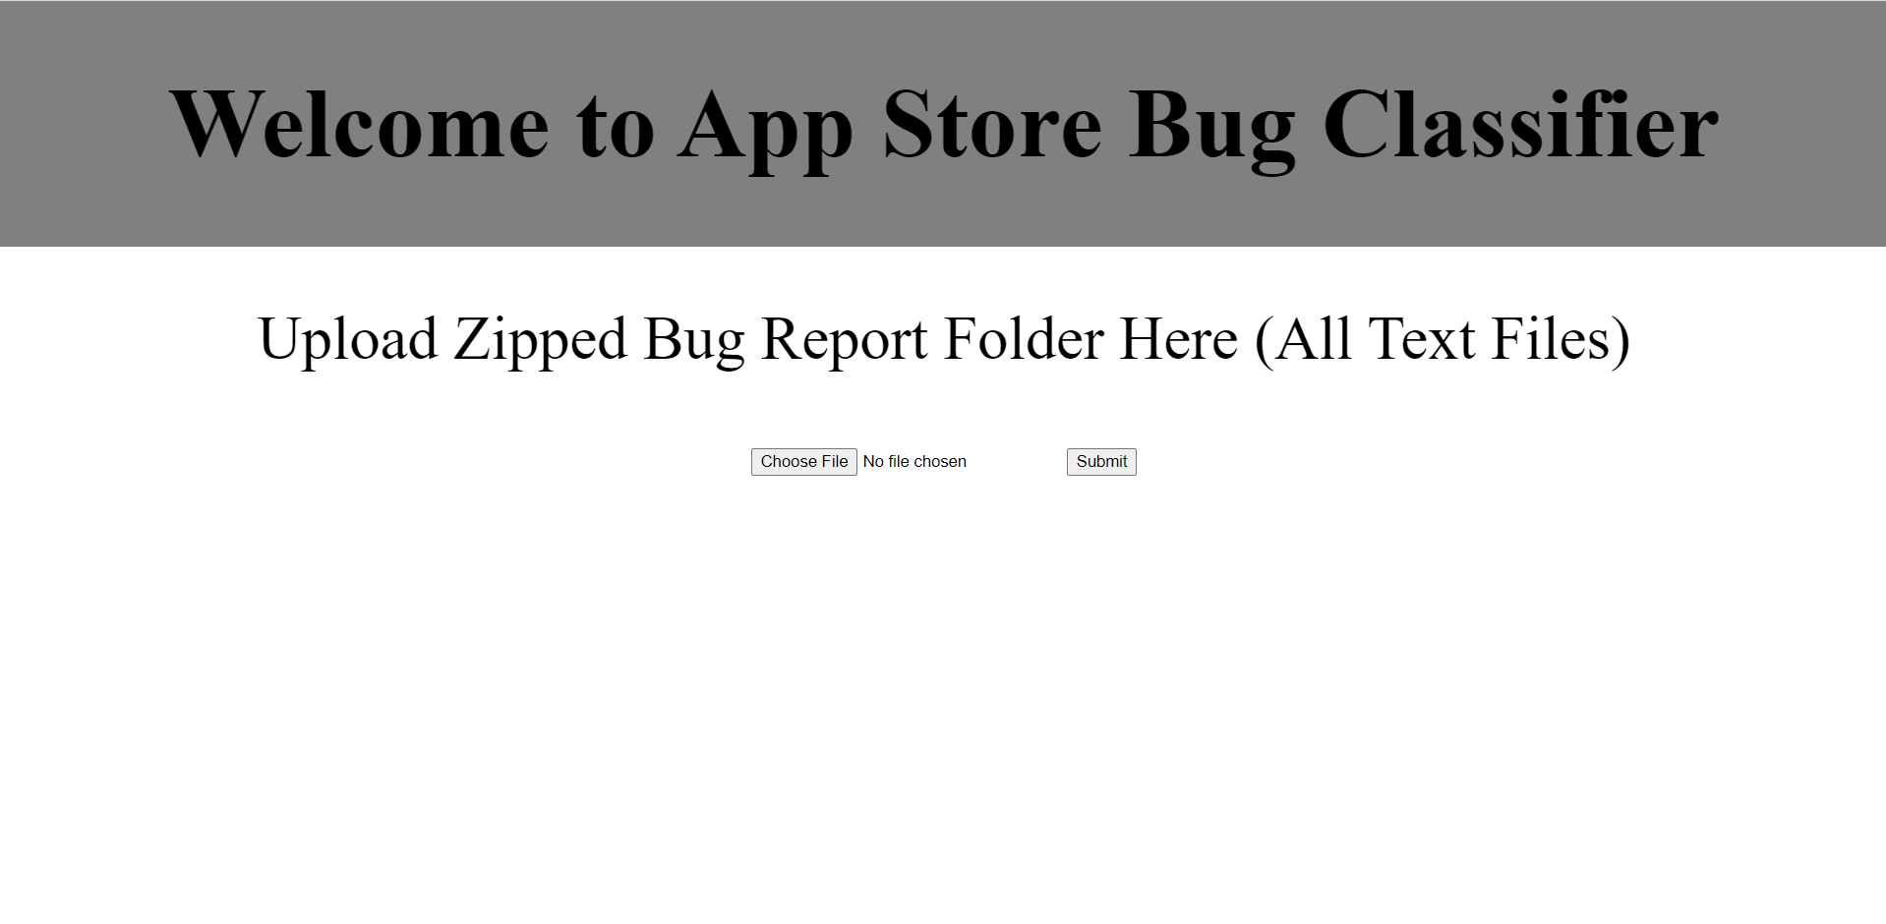
Implementation – Frontend
Home Page offers upload of bugs
Bugs must be formatted to text files
Upload a zip file of text file bug reports
Submit checks validity of file

Slide 10
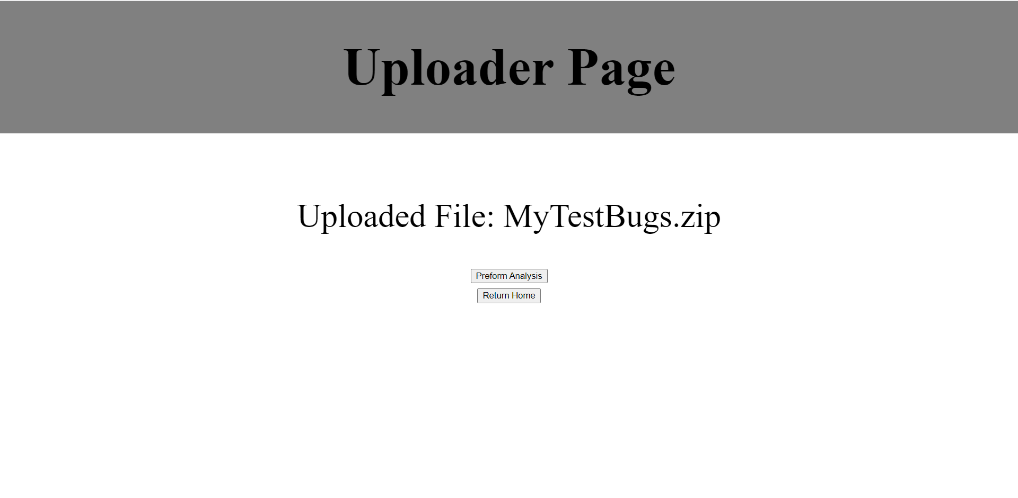
Implementation – Frontend
Uploader Page confirms uploaded file
Also processes uploaded file and prepares for analysis
If correct file, preform analysis button runs the actual analysis
Provides a return home option if incorrect file uploaded

Slide 11
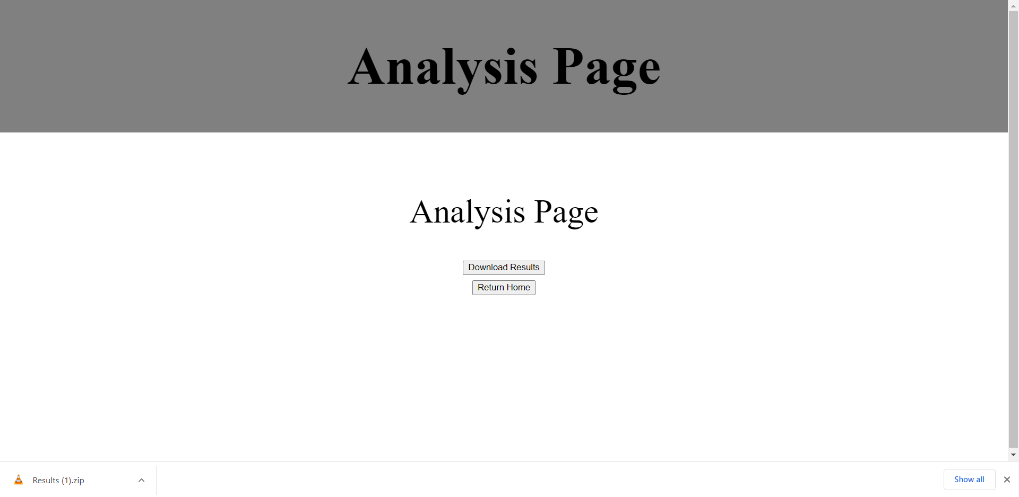
Implementation – Frontend
Analysis Page runs analysis and classification
Runs prior to page load, can take a few seconds to process
Provides download results button to return the results from analysis
Also offers return home button

Slide 12
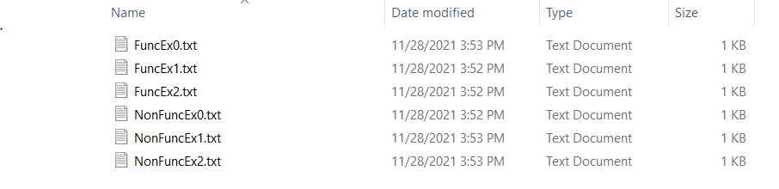
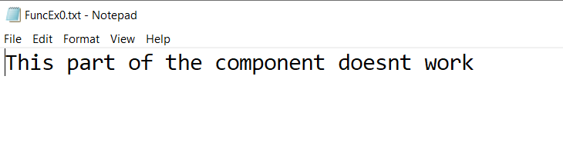
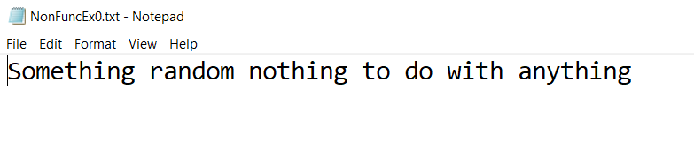
Evaluation
Example Shown
Functional Only Currently
3 Functional Bugs
3 Non-Functional Bugs
Folder Ex

Slide 13
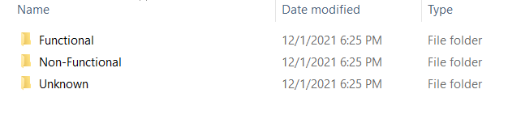
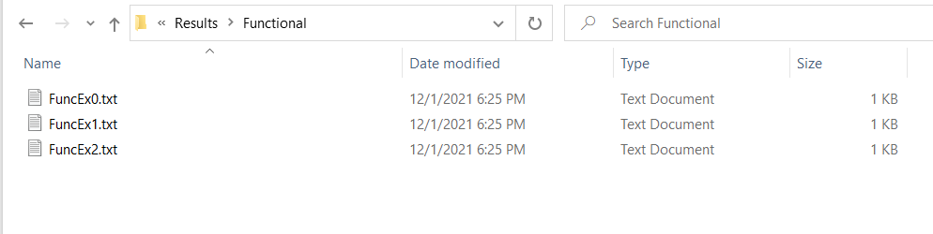
Evaluation
Example Shown
Results Folder Created
Following Structure
In this example, 100% accuracy

Slide 14
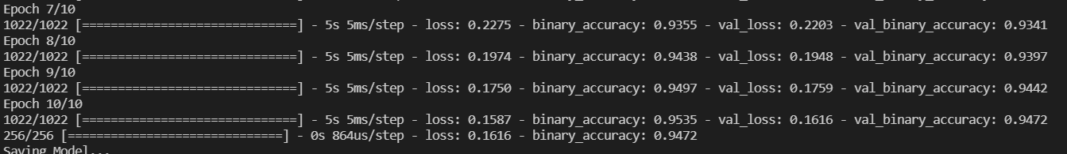
Evaluation
Snippet of Training
95% accuracy
Somewhat biased, preformed on validation set
Needs more testing

Slide 15
Future Considerations
Add different categories
Test across more apps
Use more diversified training set
Create cleaner UI
Use a better Machine Learning structure

